Slide 1
Lab 2

Slide 2
Purpose
To demonstrate knowledge of
Strings
Simple regular expressions
Formatting output
Builder pattern
Inner classes
Object design
Jar Files

Slide 3
Goal
Create a commandline program which reads customer data, creates Customer objects, adds them to an array, and prints a simple Customer report

Slide 4
Classes
Lab2
Customer
CustomerReader
CustomerReport
Validator

Slide 5
Builder
Using the NutritionFacts example as a guide, modify the Customer class to use the Builder pattern. You will need to:
add a public static class Builder inner class
the necessary setter methods
and a build() method
The id and phone must be required fields
You would construct the Customer object similar to how NutritionFactsTests creates a NutritionFacts object
Given the extra requirement, this lab will be marked out of 4 rather than 3

Slide 6
Input
One single string
"1|Fred|Fish|5707 Sidley St|Burnaby|V5J 5E6|(604) 433-5004|fredfish@imperial.net|20080322:2|Laurie|Nash|2816 Commercial Dr|Vancouver|V5N 4C6|(604) 876-0182|laurieeenash@modern.com|20140828:3|Conrad|Washington|13479 King George Blvd|Surrey|V3T 2T8|(604) 588-4988|cwash@daytona.net|20110712:4|Jeanette|Price|21000 Westminster Hwy|Richmond|V6V 2S9|(604) 276-2552|priceizrite@pacific.com|20151003:5|Mark|Chan|3766 E 1st Ave|Burnaby|V5C 3V9|(604) 293-1022|mchan|20100401"
If an email is not valid, it’s replaced with “N/A”

Slide 7
Output
Customer Report
----------------------------------------------------------------------------------------------------------------------------------
#. ID First name Last name Street City Postal Code Phone Email
----------------------------------------------------------------------------------------------------------------------------------
1. 000001 Fred Fish 5707 Sidley St Burnaby V5J 5E6 (604) 433-5004 fredfish@imperial.net
2. 000002 Laurie Nash 2816 Commercial Dr Vancouver V5N 4C6 (604) 876-0182 laurieeenash@modern.com
3. 000003 Conrad Washington 13479 King George Blvd Surrey V3T 2T8 (604) 588-4988 cwash@daytona.net
4. 000004 Jeanette Price 21000 Westminster Hwy Richmond V6V 2S9 (604) 276-2552 priceizrite@pacific.com
5. 000005 Mark Chan 3766 E 1st Ave Burnaby V5C 3V9 (604) 293-1022 N/A

Slide 8
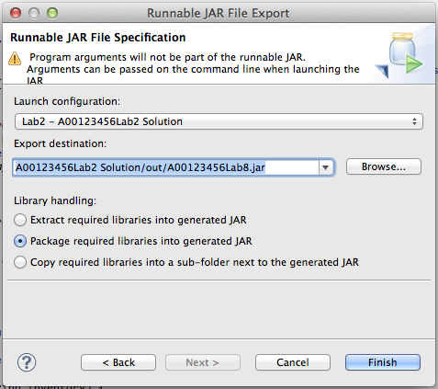
Create the jar File
File > Export > ‘Runnable Jar File’ > Next
Select Lab2
Destination is an ‘out’ folder at the same level as your src folder – you’ll need to create it in the save dialog

Slide 9
Argument Errors
0 commandline arguments, print:
Usage java -jar A00123456Lab2.jar <input string>

Slide 10
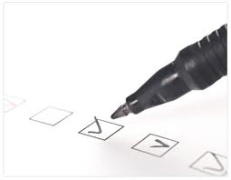
Checklist
I have:
Met all the functional requirements
Followed the java coding conventions
Used a file template to add my name & student number to all source files
Used packages; the root package is my student number, ex. package a00123456…;
Used great object-oriented design
Run “Source > Format” on my project
Included all source code & required resources
Created a runnable Jar file for testing
Zipped up all my files into a single file named <your student number>.zip, ex. A00123456.zip
Submitted my lab before the due date & time
NOTE! No runnable Jar file, no mark

